Slide 1
Capstone Project @GA
Google Landmark recognition challenge
--by Wei Fu
August 2018

Slide 2
Outline
Introduction
Exploratory data analysis
Image classification model
Classification result output
Future work

Slide 3
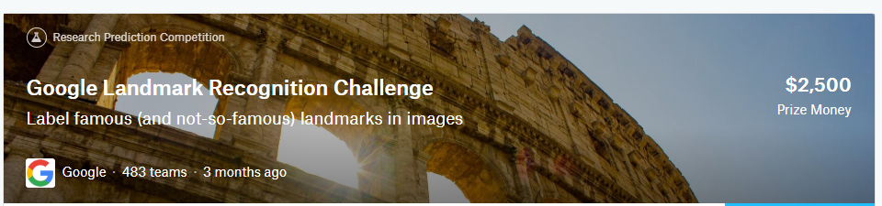
A competition posted at Kaggle.com in May 2018
Goal:
to predict landmark labels directly from image pixels
Challenge:
there are a total of 15K different famous or infamous landmarks(classes) involved and the number of training examples per class may not be very large

Slide 4
Data source
Link to the datasets: https://www.kaggle.com/google/google-landmarks-dataset
Train.csv:
This file contains information regarding the training images to be used in the recognition task associated to the Google-Landmarks dataset. These images may also be useful to train models for the retrieval task. The first column contains the train image ID, the second column contains its URL, and the third column contains its label.
Test.csv:
This file contains information regarding the test images to be used in the recognition and retrieval tasks associated to the Google-Landmarks dataset. The first column contains the test image ID, and the second column contains its URL.

Slide 5
Success Metrics
Correctly identify in which class the each test image is and the corresponding confidence level and the output format is:
[{cl1 for class1},{cl2 for class2},...,{clk for classk}], k=1,2,..10

Slide 6
Project value
It will be applied to
landmark recognition and classification
landmark collection reorganization
It can be transferred to
facial recognition
Handwriting recognition and verification
Conventional publications digitalization

Slide 7
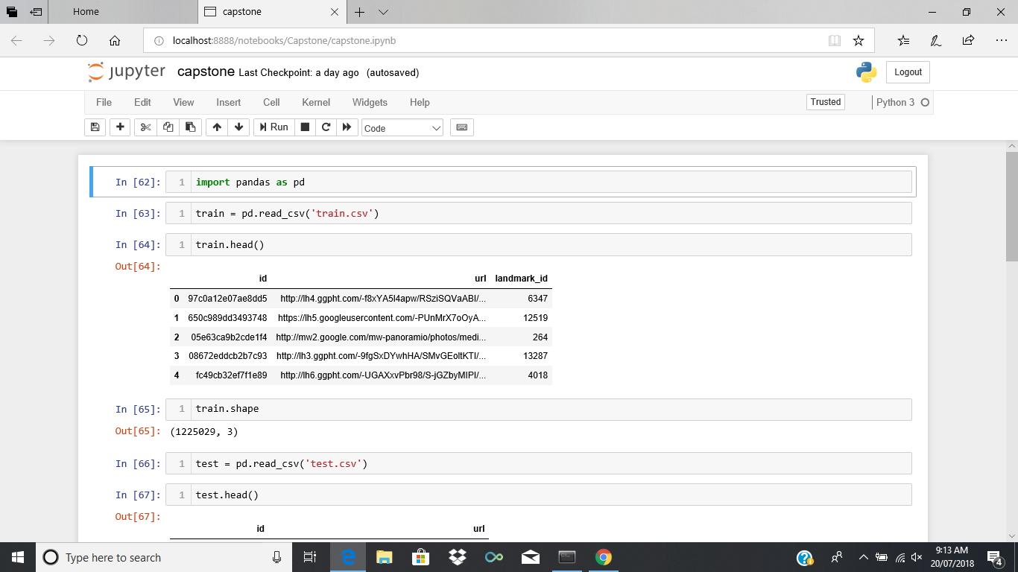
Train data
Note: 1.2million images are supplied as train data

Slide 8
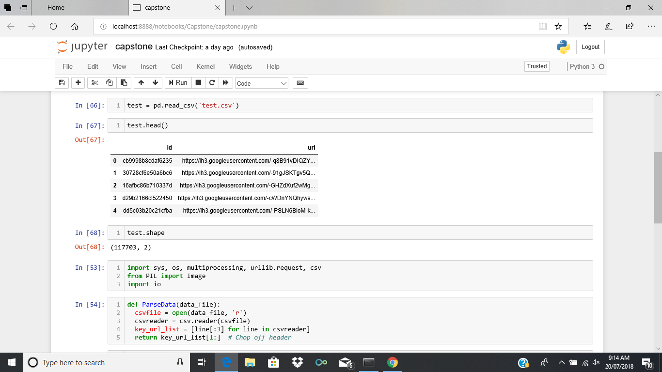
Test data
Note: 117 thousands images are supplied as test data

Slide 9
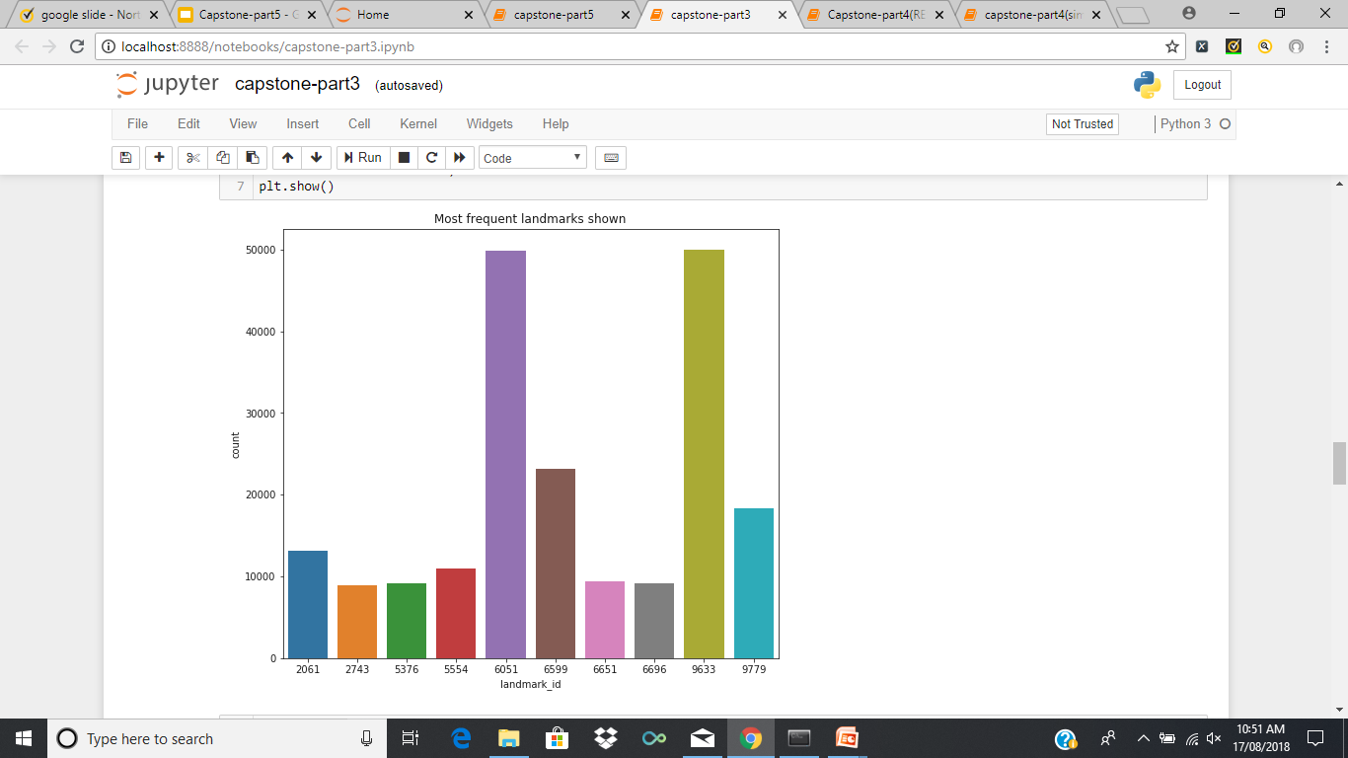
Top 10 most popular landmarks in train data
1- 9633
2- 6051
3- 6599
4- 9779
5- 2061
6- 5554
7- 6651
8- 5376
9- 6696
10- 2743

Slide 10
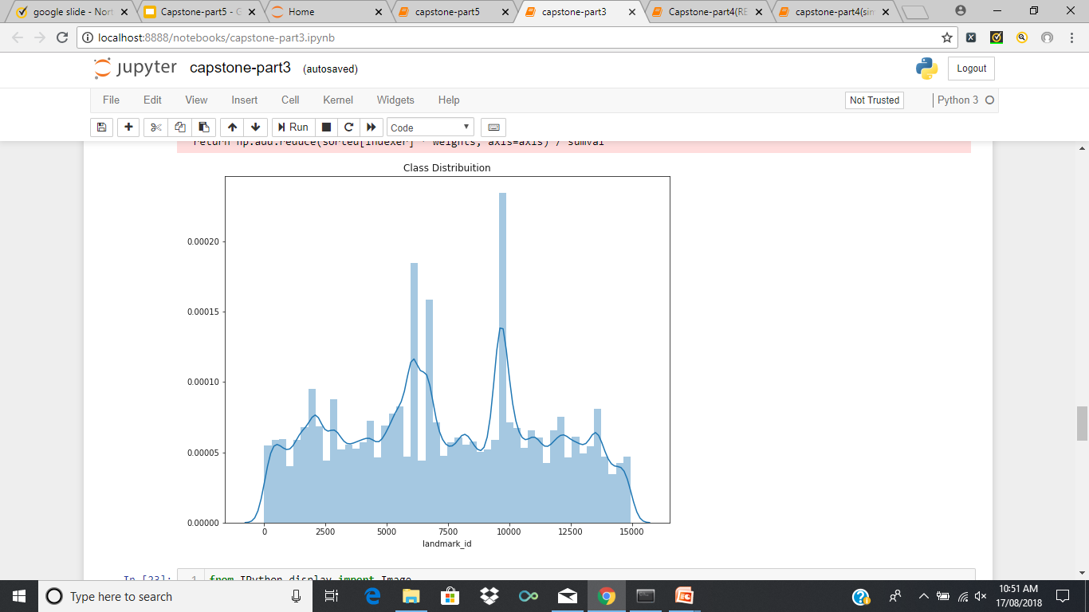
Landmark distribution

Slide 11
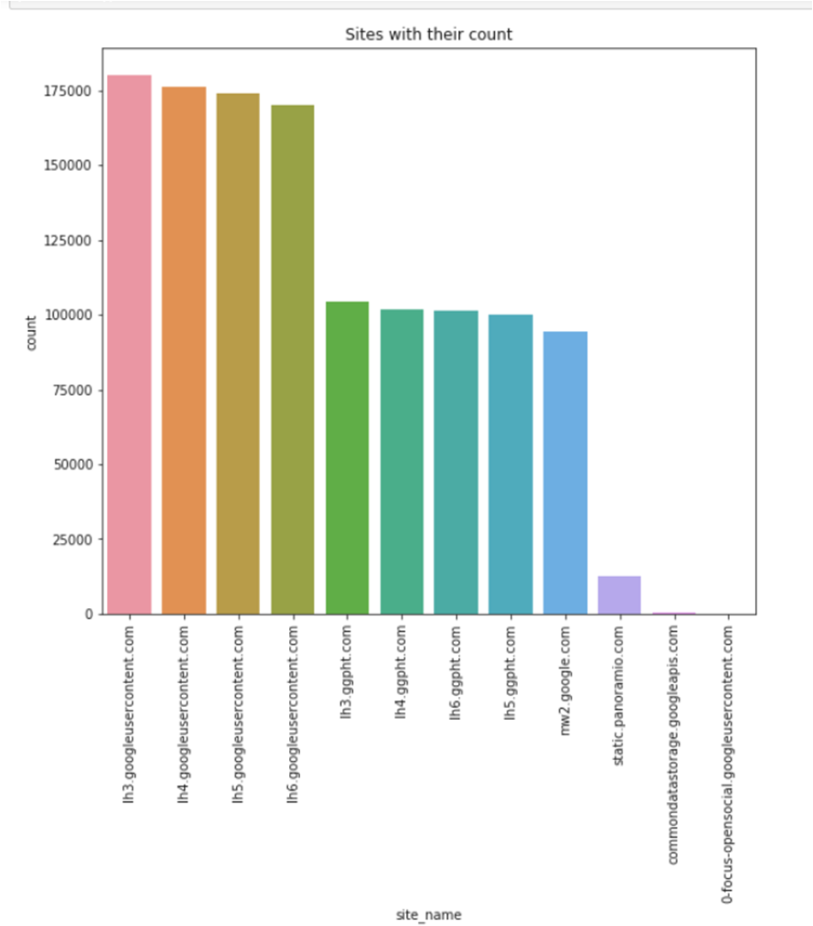
Image storage websites
Lh3.googleusercontent.com
Lh4.googleusercontent.com
Lh5.googleusercontent.com
Lh6.googleusercontent.com
Lh3.ggpht.com
Lh4.ggpht.com
Lh6.ggpht.com
Lh5.ggpht.com
Mw2.google.com
Static.panoramio.com
Commondatastorage.googleapis.com
0-focus-opensocial.googleusercontent.com

Slide 12
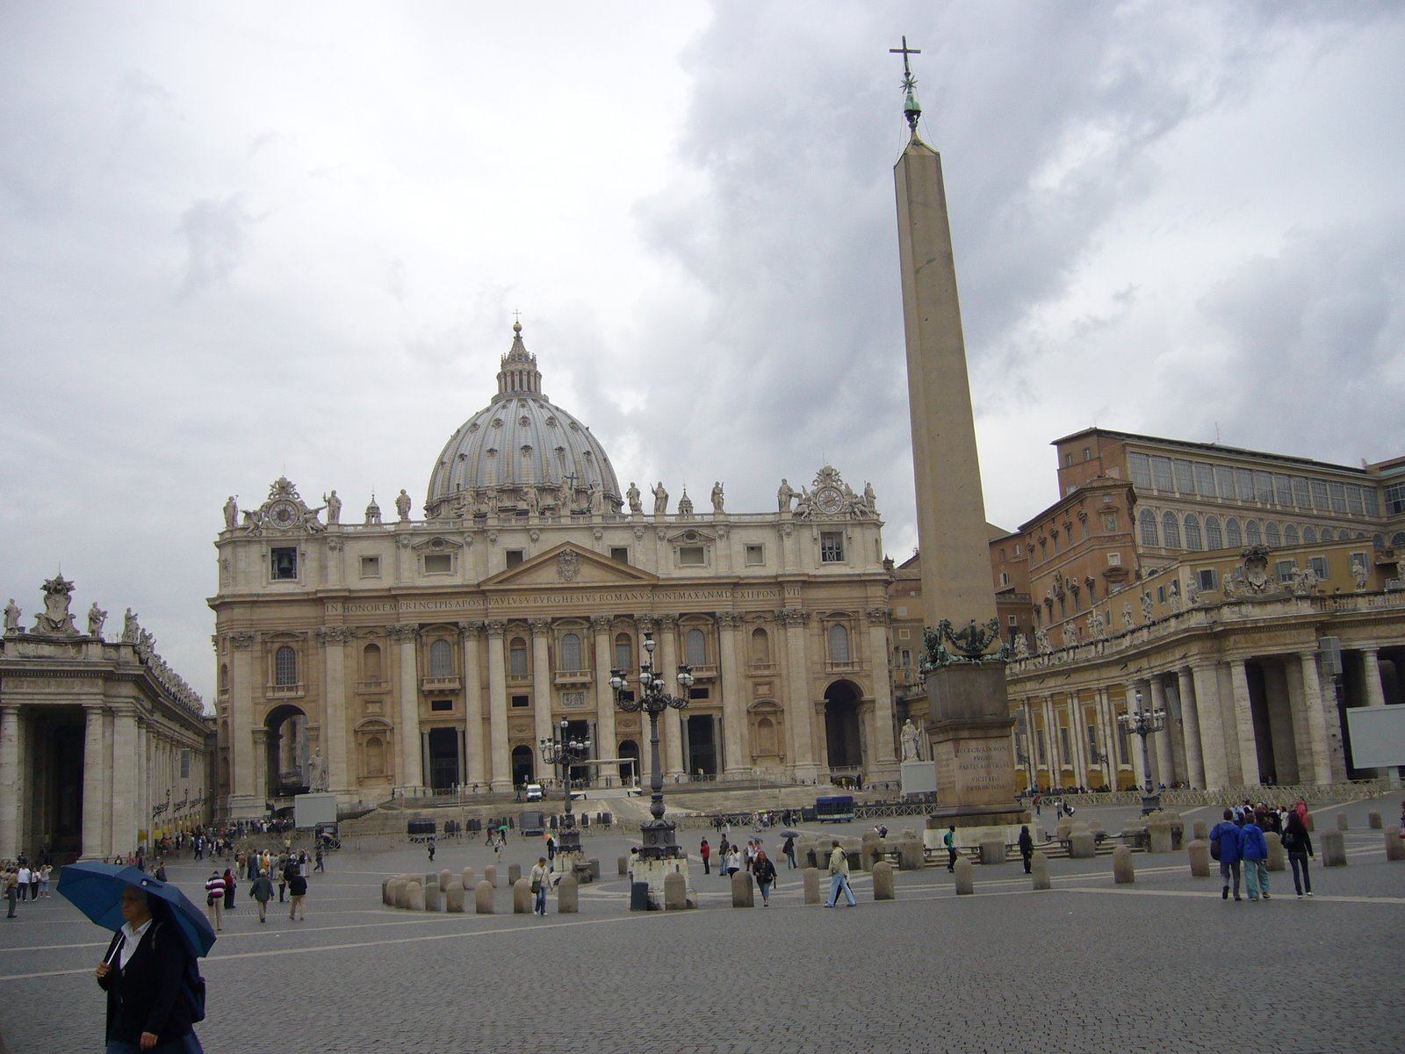
St. Peter's Basilica (Latin: Basilica Sancti Petri), is an Italian Renaissance church in Vatican City, the papal enclave within the city of Rome.
The most popular landmark: 9633

Slide 13
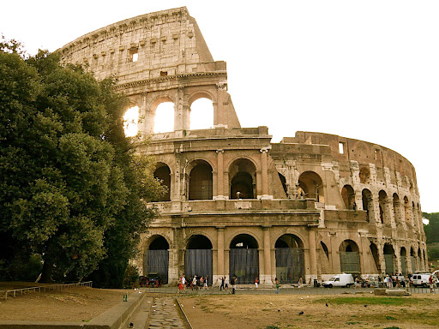
The Colosseum or Coliseum also known as the Flavian Amphitheatre is an oval amphitheatre in the centre of the city of Rome, Italy
The second most popular landmark: 6051

Slide 14
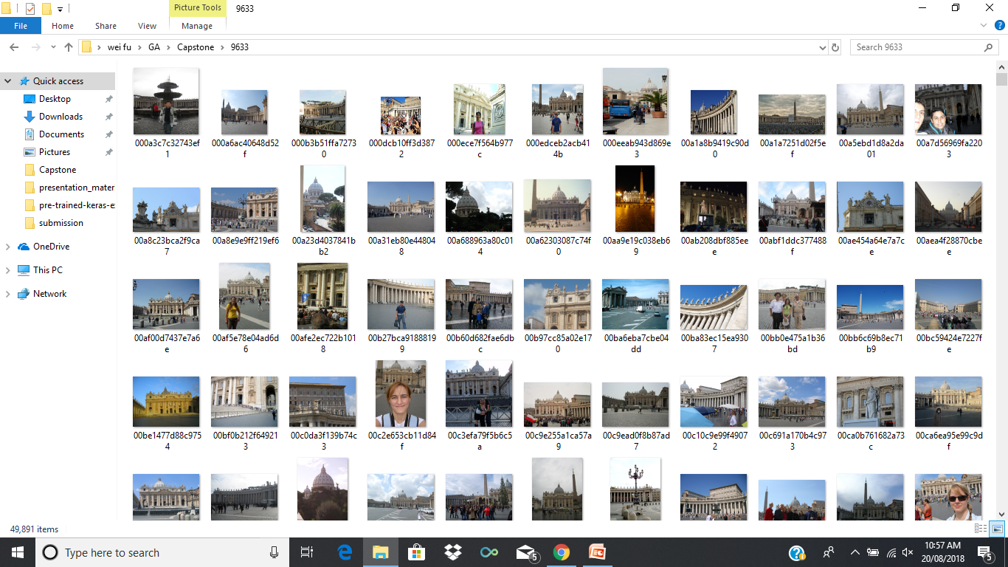
The most popular landmark: 9633

Slide 15
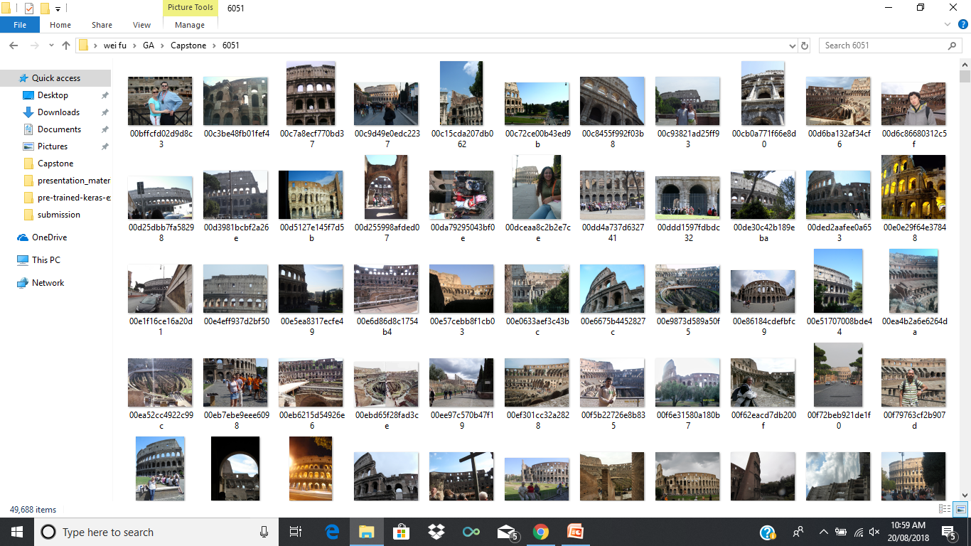
The second most popular landmark: 6051

Slide 16
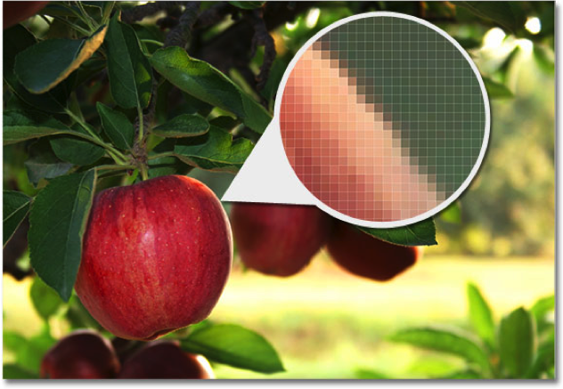
What is a image?
B
G
R

Slide 17
Plans
To build or retrain a convolutional neural network (CNN) model
To feed the model with the train data
To predict the landmark and evaluate the outcome
To optimize the model based on the outcome evaluations
To report the final results

Slide 18
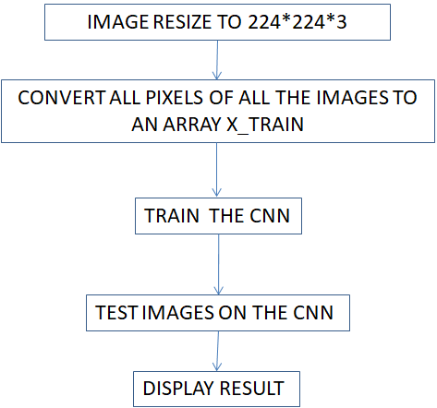
How do we classify images?

Slide 19
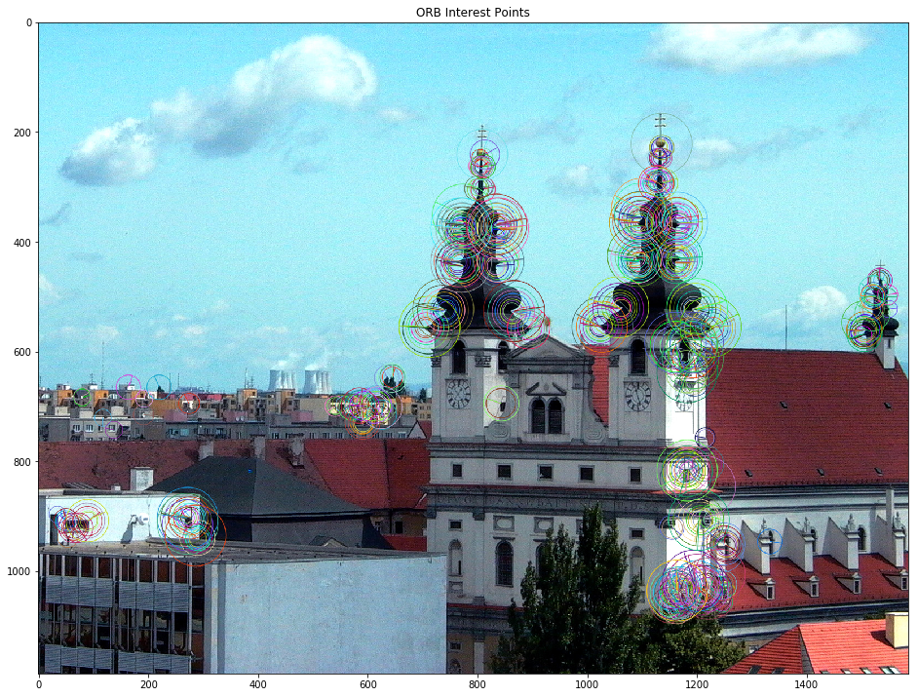
What features can be extracted?
To extract
Corners
Edges
Tips
Holes
Picture source: https://www.kaggle.com/wesamelshamy/image-feature-extraction-and-matching-for-newbies

Slide 20
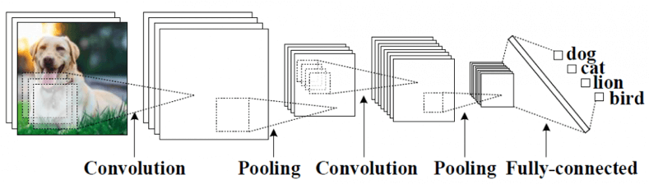
What does CNN* look like?
* CNN: convolutional neural network

Slide 21
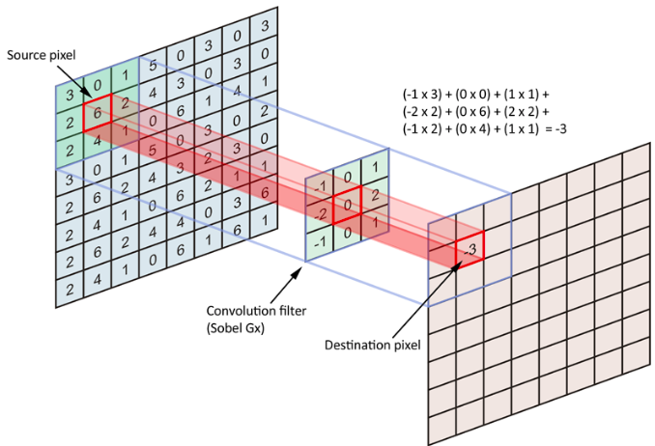
What does convolution do?

Slide 22
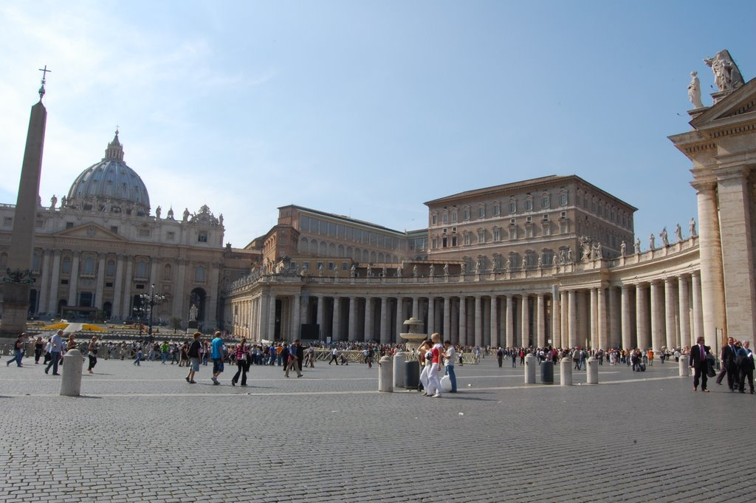
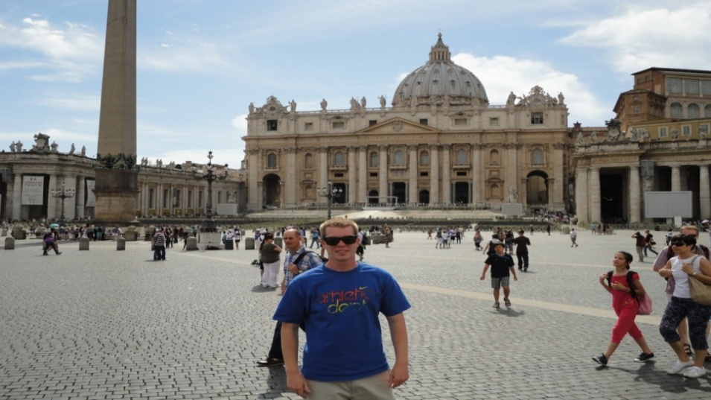
Classification results on two classes
[0.96, 0.04]
[0.81, 0.19]
(9633, 6051)
(9633, 6051)

Slide 23
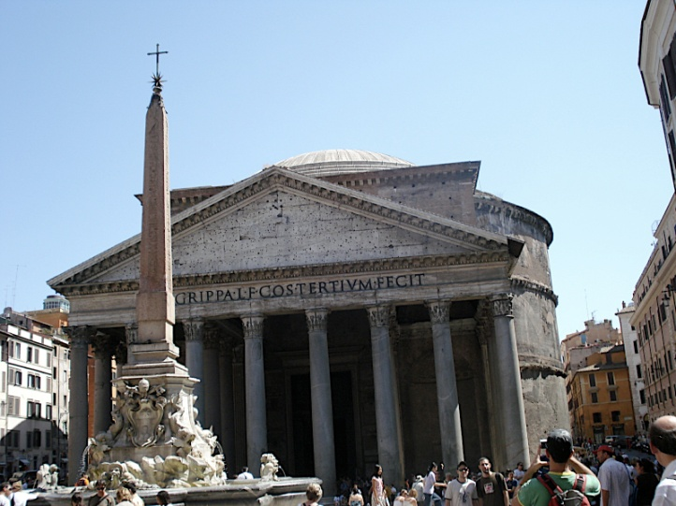
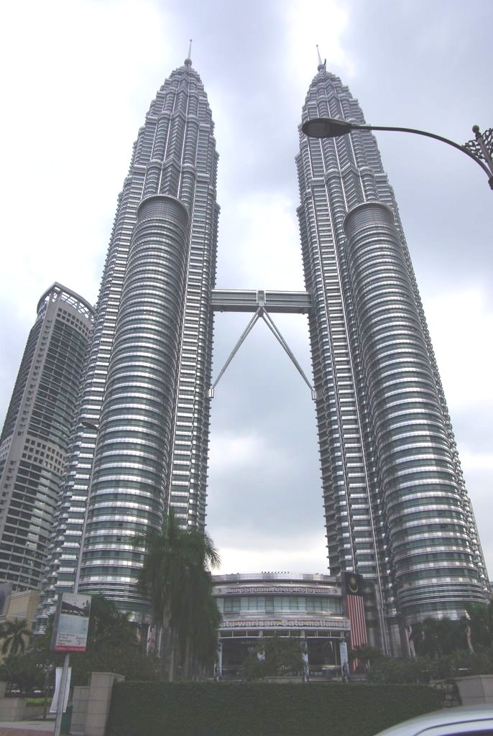
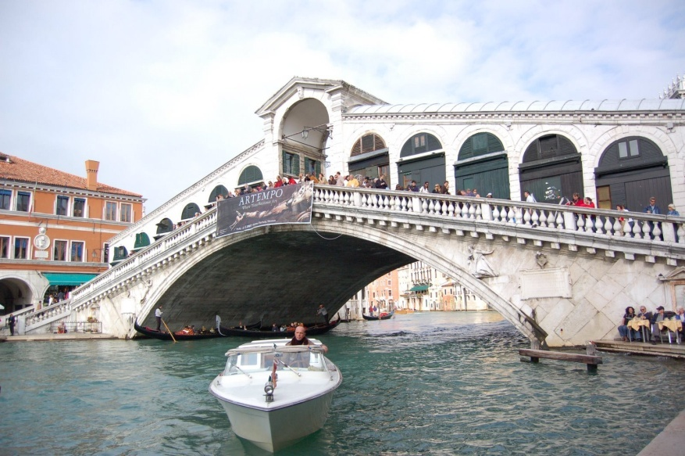
Classifying five classes
-landmark id: 2743, 5376, 5554, 6051, 9633
2743
Petronas Towers
(Kuala Lumpur, Malaysia)
5554
Rialto bridge
(Venice, Italy)
5376
Pantheon
(Rome, Italy)

Slide 24
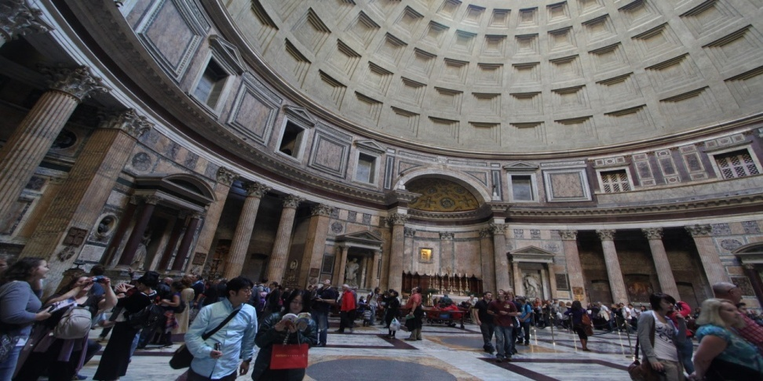
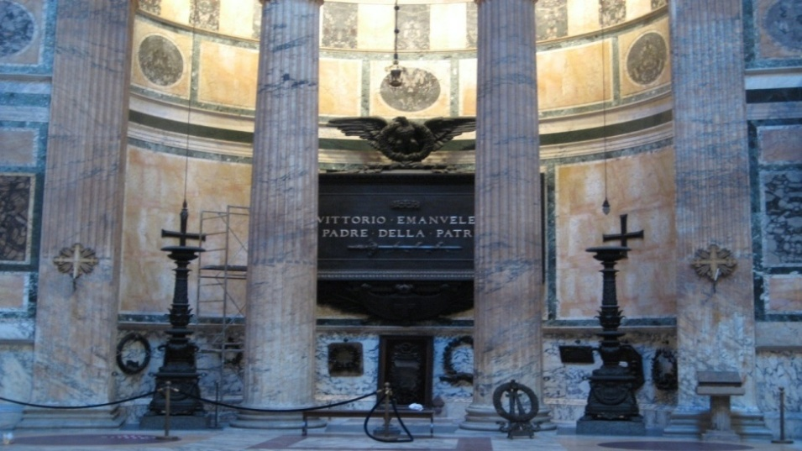
[0.62, 0.03, 0.11, 0.08, 0.16]
Classifying five classes
landmark id: 2743, 5376, 5554, 6051, 9633
[0.87, 0.01, 0.02, 0.05, 0.05]
(2743, 5376, 5554, 6051, 9633)
(2743, 5376, 5554, 6051, 9633)

Slide 25
Accuracy summary
Accuracy | Training on 500 images per class | Training on 1000 images per class
2 classes | Up to 85% | Up to 96%
5 classes | Up to 65% | Up to 77%
10 classes | 10% | N/A
CNN Model performance

Slide 26
Future work
To improve the model’s performance:
Training the model on more images
Training the model on more classes
To optimize image preparation

Slide 27
Thank you
Questions?

